Slide 1
Project Meeting May 19

Slide 2
ARIMA Downsamplings
Year
6Me
GapMe
Me: removed due to extensive interpolation

Slide 3
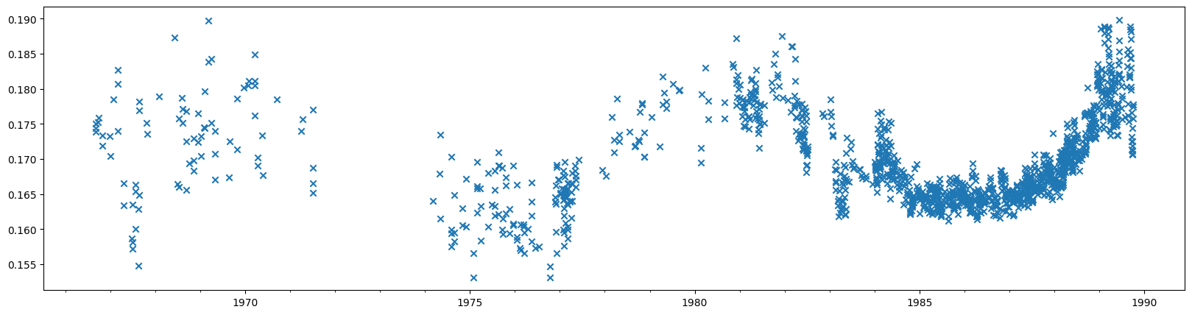
Datasplit chronological
Inconsistent variance: log transform

Slide 4
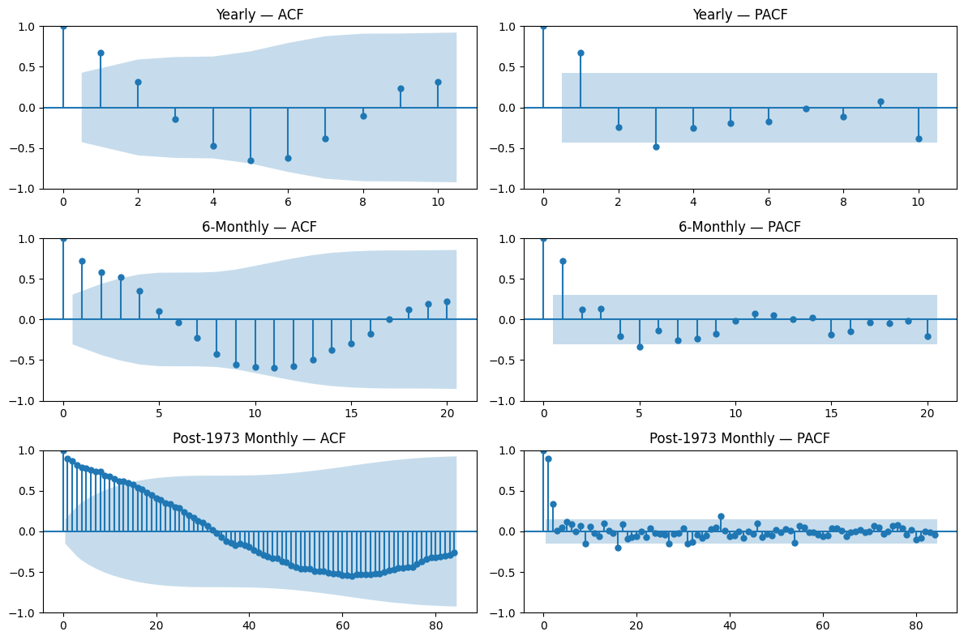
ACF/PACF
Looks stationary
Sinusoid corresponds with expected period
Lack of data to show full cycle

Slide 5
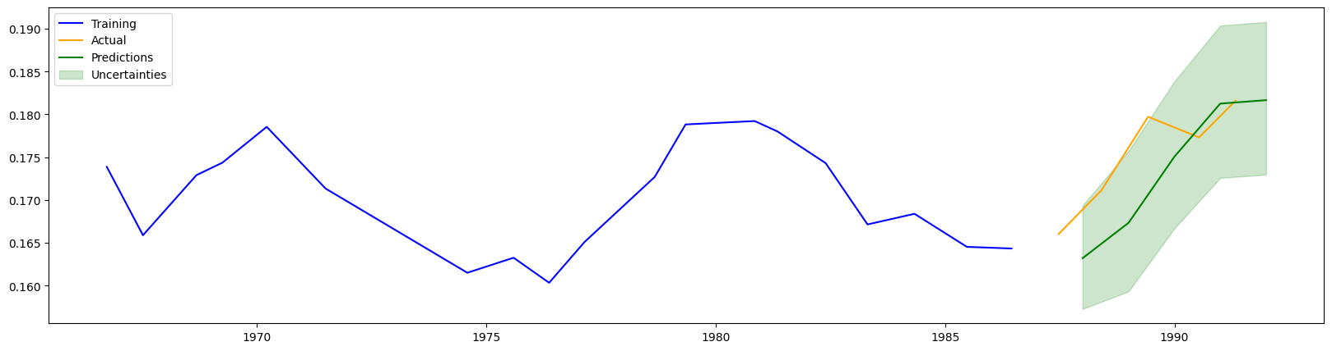
_year downsample

Slide 6
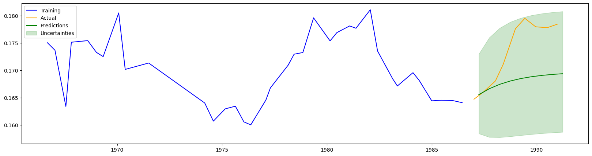
_6me downsample

Slide 7
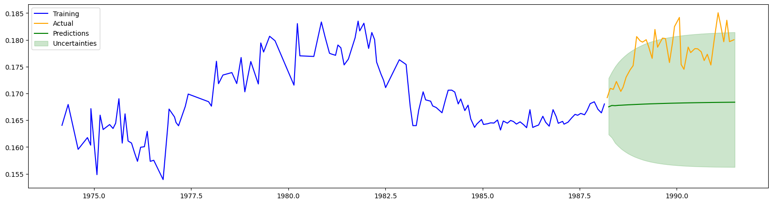
_gapme downsample

Slide 8
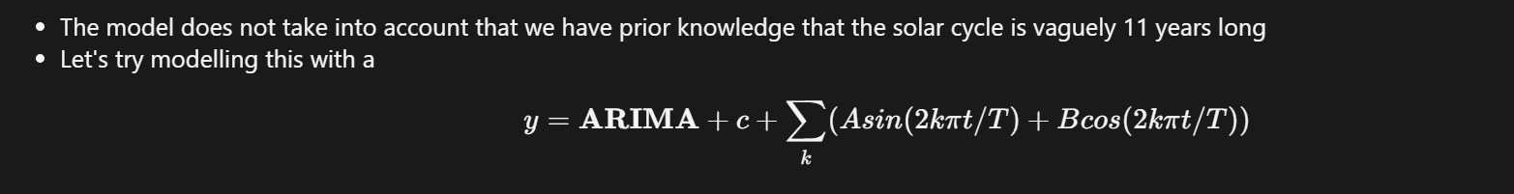
Fourier ARIMA

Slide 9
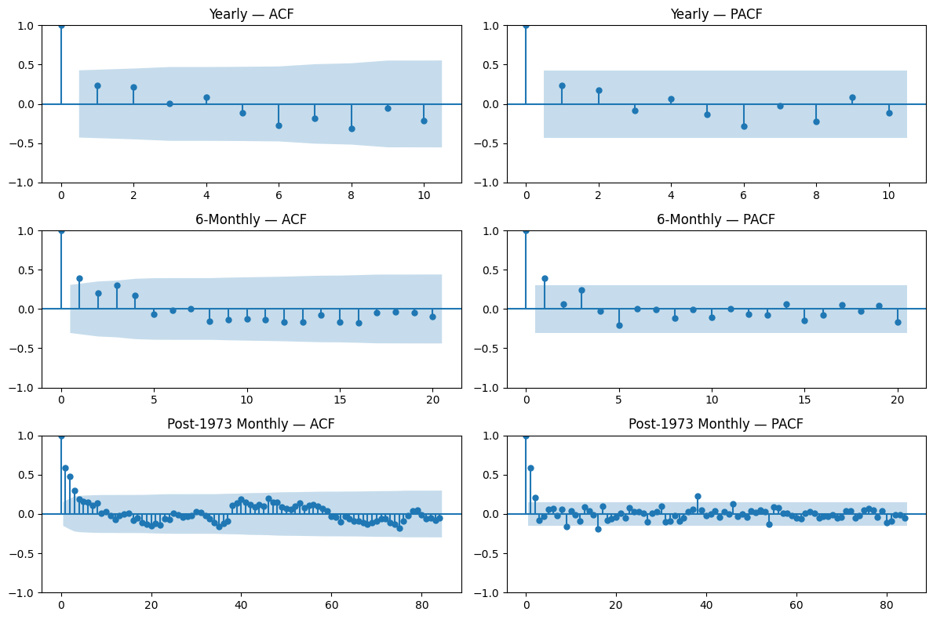
New ACF/PACF
Looks stationary
Looks dependent on very short-term effects.

Slide 10
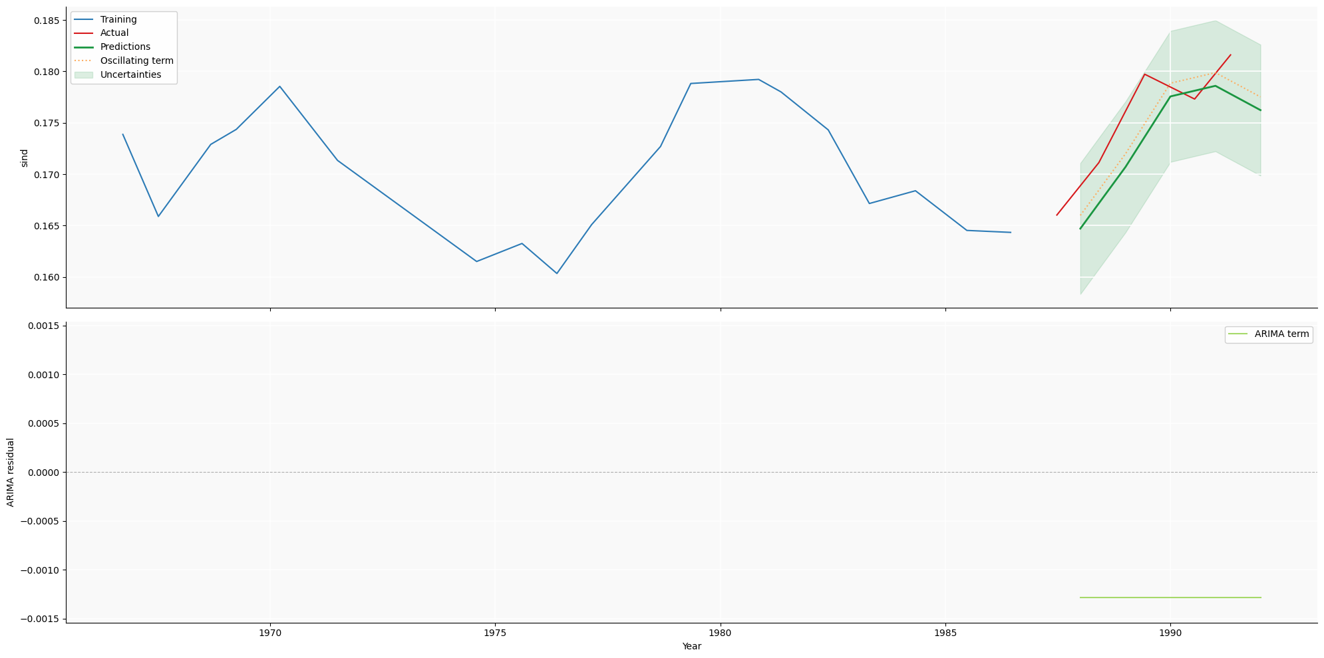
_year downsample

Slide 11
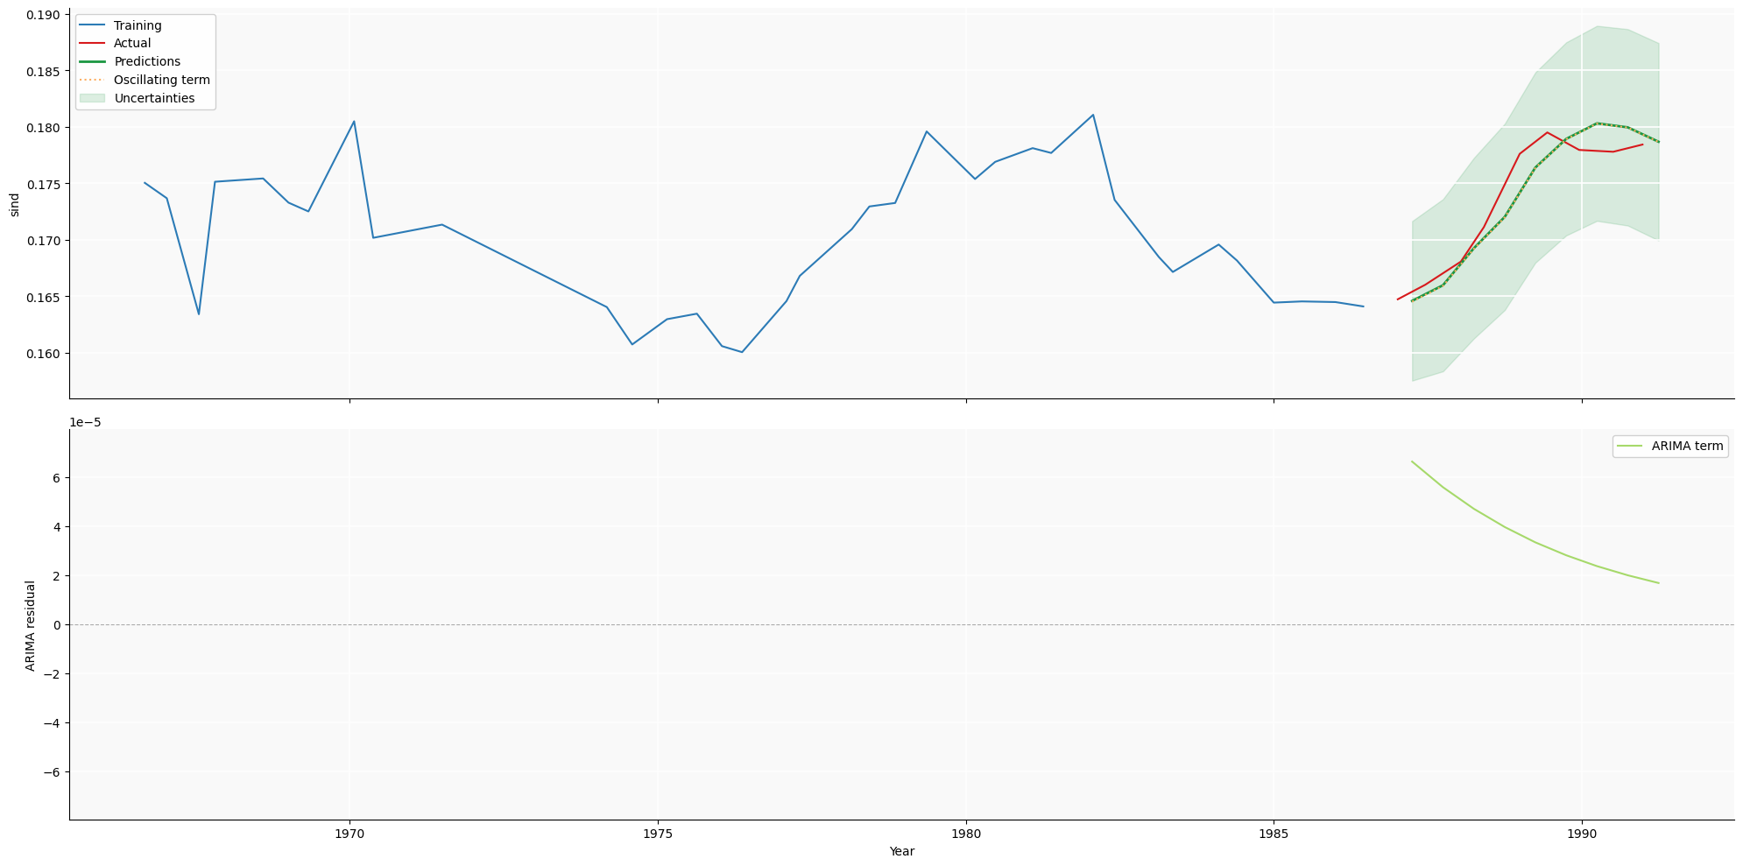
_6me downsample

Slide 12
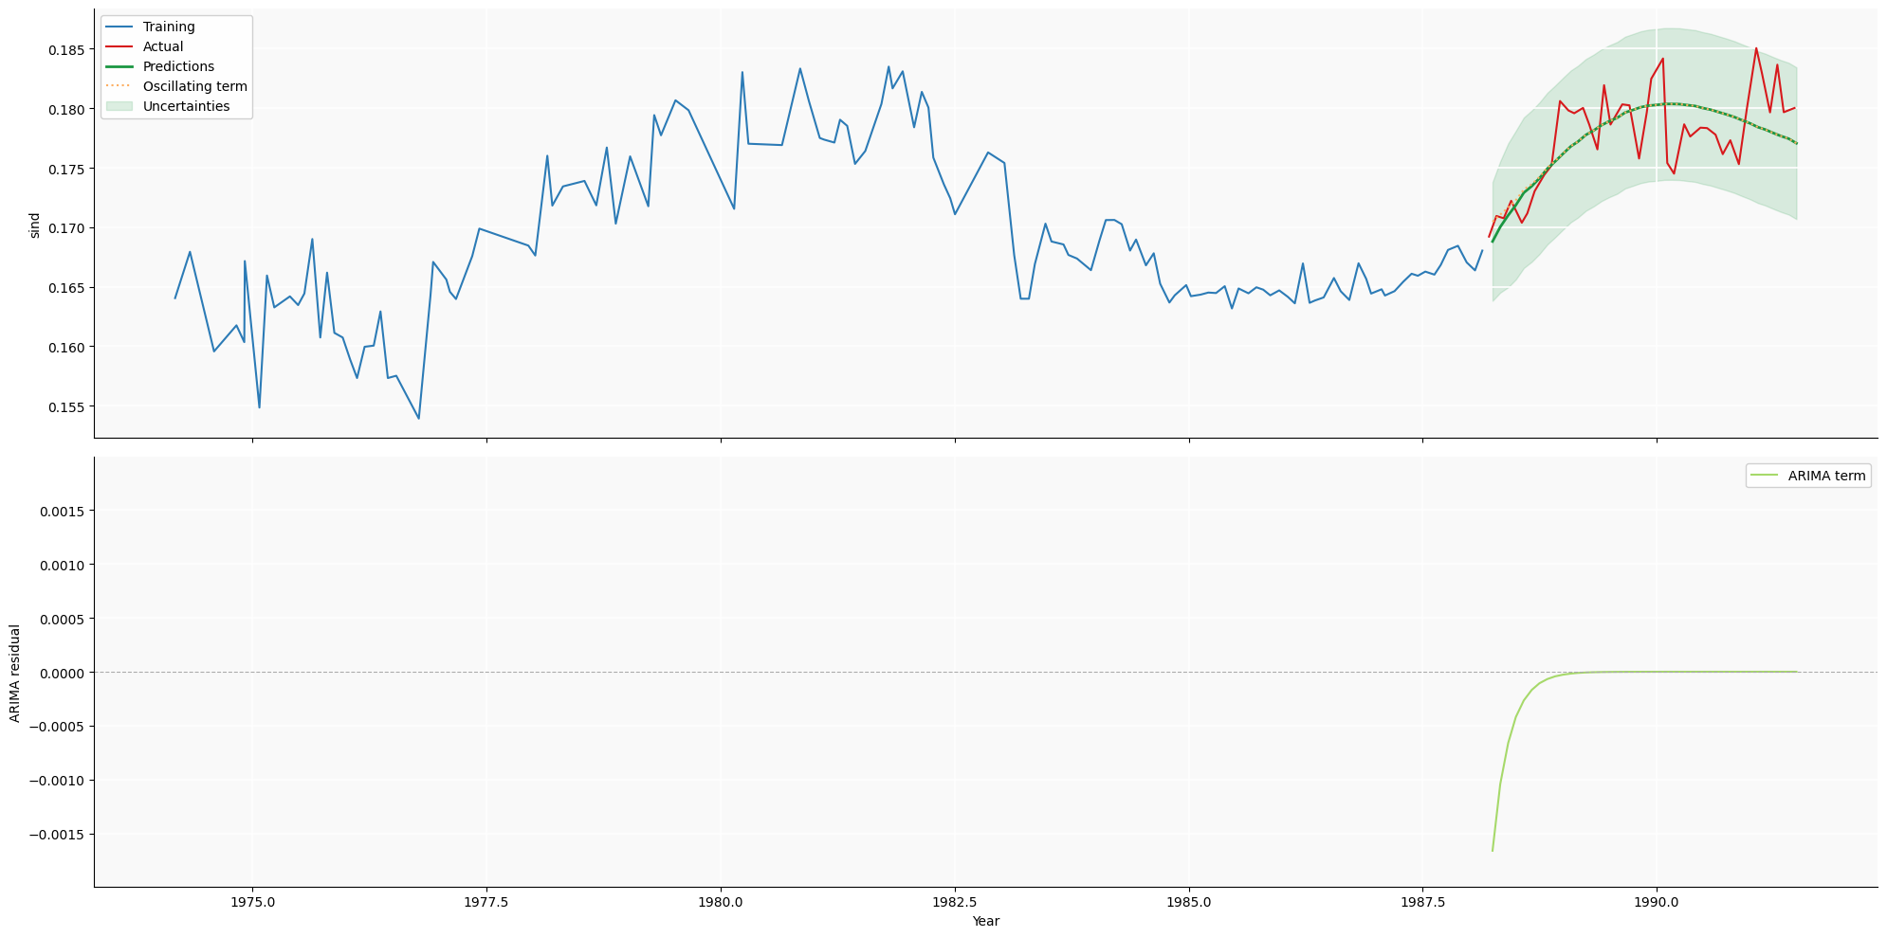
_gapme downsample

Slide 13
Conclusions
ARIMA dominated by Fourier term
ARIMA forces downsampling: makes our limited training data even worse.
Motivates GPR which can deal with different values intervals.
Discussion of project goals: implement the forecast?
Questions about key paper:
What progress has been made on the recommendations in the paper?
What is the current state of the work?

